Slide 1
ShareList
Hannan Khan
Yanzhi Wang
Anum Farrukh Khan
Mohammed Furkhan Shaikh
Yu Zhao
Group 6 - Coffee_Code
Iteration 1
03-08-2021
CSE 5324
Software Engineering 1 Analysis, Design, Testing

Slide 2
Agenda
Project Description
Overall Design Approach
Requirements
Use Cases
High Level Use Cases
Use Case Diagram
RUCTM
Increment Matrix
Domain Diagram
Task List
Summary Page

Slide 3
Project Description
ShareList is designed to allow users the ability to create, delegate, and track tasks that are shared among users in a group.
Our goal is to allow teams in virtual workspaces the ability to have better collaboration via shared/delegated tasks.
Think of each group as a 'project' in which members contribute towards the tasks they are assigned. It is a similar concept to a Whatsapp group. The messaging is replaced with tasks that can have users assigned to them.
Features include: group admins, group summary reports, database storage, and wireless synchronization of database.

Slide 4
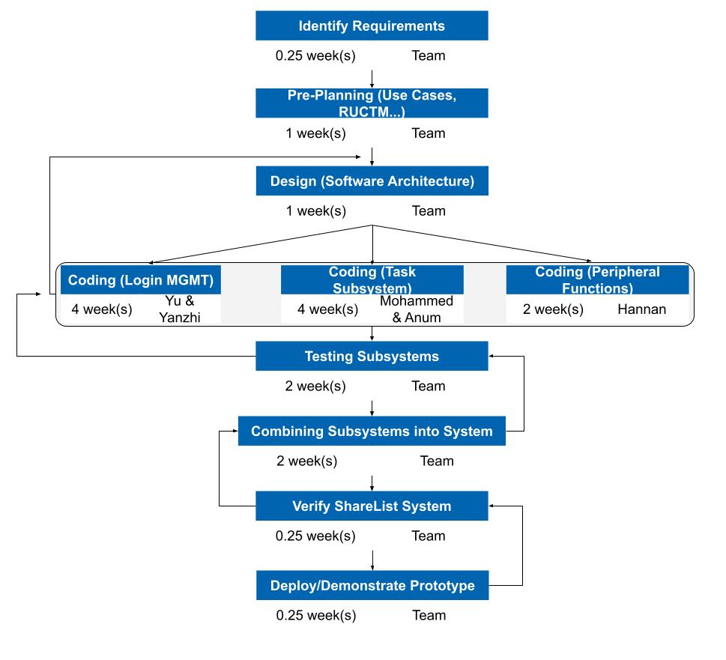
Overall Design Approach

Slide 5
Requirements

Slide 6
Req ID | Req Statement | Line #
R1 | The system shall provide for authenticated login to the ShareList app.
R1.1 | Register. | 40
R1.2 | Login.
R1.3 | Log Off.
R1.4 | Reset password.
R2 | The system shall provide admins the ability to:
R2.1 | Add tasks. | 41,42
R2.2 | Remove tasks.
R2.3 | Edit tasks.
R2.4 | Assign tasks.
R2.5 | Add users to group. | 46,47
R2.6 | Remove users from the group. | 34,35
R2.7 | Add new Admins to group. | 18,47
R2.8 | Delete group | 48,49
R2.9 | Edit group. | 46,47
R3 | The system shall provide users/admins the ability to:
R3.1 | Mark task as completed. | 44,45
R3.2 | Create groups. | 46,47
R4 | The system shall provide the ability to search by keywords. | 43
R5 | The system shall provide tasks the ability to:
R5.1 | Be visible to all members in that group. | 22,23
R5.2 | Have users assigned to it. | 41,42
R5.3 | Have assigned users mark it as completed. | 44,45
R6 | The system shall provide tasks the following properties: start time, completion time, due date, time spent, title, description, users assigned | 50
R7 | The system shall provide users the ability to create groups, and have admin status when they do. | 46,47
R8 | The system shall provide a database used for storing information related to tasks, groups, users. | 59
R9 | The system shall provide wireless resources used for syncing between each user's device and the database. | 60
R10 | The system shall provide a group summary function, which will accomplish: | 50
R10.1 | Calculating and reporting the tasks completed. | 52
R10.2 | Calculating and reporting the in-progress tasks. | 53
R10.3 | Calculating and reporting the tasks not completed by due date. | 54
R11 | The system shall provide an update function which will update the UI, check for changes within the app data, and sync the current tasks with the database. | 55,56

Slide 7
Use Cases
Use Case # | Use Case Name
UC1 | Login
UC1.1 | Register.
UC1.2 | Login.
UC1.3 | Log Off.
UC1.4 | Reset password.
UC2 | Manage task
UC2.1 | Add tasks.
UC2.2 | Remove tasks.
UC2.3 | Edit tasks.
UC2.4 | Assign tasks.
UC3 | Manage group
UC3.1 | Add users.
UC3.2 | Remove users.
UC3.3 | Add admins.
UC3.4 | Delete groups
UC3.5 | Edit groups.
UC4 | Mark task as completed
UC5 | Create groups.
UC6 | Search by keywords.
UC7 | Generate summary

Slide 8
High Level Use Cases
UC 1.1: Register
- TUCBW the user entering required details and clicking the register button.
- TUCEW the user being registered successfully.
UC 1.2: Login
- TUCBW the user enters the username and password.
- TUCEW the user successfully logs in and can see the home page.
UC 1.3: Log Off
- TUCBW the user clicks on the logout button.
- TUCEW the user is successfully logged out and can see the login page.
UC 1.4: Reset Password
- TUCBW the user clicks on the reset password option.
- TUCEW the password of the user is changed.
UC 2.1: Add Tasks
- TUCBW the admin clicking on the “Add Tasks” option.
- TUCEW the admin adding the task successfully and can see the added tasks.
UC 2.2: Remove Tasks
- TUCBW the admin clicking the “Remove Task” option.
- TUCEW the admin removing the task successfully.
UC 2.3: Edit Tasks
- TUCBW the admin clicking on the “Edit Task” option and making the necessary changes.
- TUCEW the admin being able to see the changes made to the respective tasks.
UC 2.4: Assign Tasks
- TUCBW the Admin assigning the task to particular users.
- TUCEW the users get assigned new tasks.
UC 3.1: Add users
- TUCBW the admin clicking on the add member option.
- TUCEW the user being added to the selected group.
UC 3.2: Remove users
- TUCBW the admin selecting a user to be removed from the group.
- TUCEW the user is no longer a member of the group.
UC 3.3: Add admins
- TUCBW the admin selecting a member to be an admin.
- TUCEW the selected user being the admin for the group.
UC 3.4: Delete Group
- TUCBW the admin selecting the delete group option.
- TUCEW the group, related tasks and users, being removed from the records.
UC 3.5: Edit Group
- TUCBW the admin selecting the edit group option.
- TUCEW the group information is updated by the admin.
UC 4: Mark task as completed
- TUCBW the users selecting their assigned tasks to be marked complete.
- TUCEW the tasks information being updated by the users.
UC 5: Create Group
- TUCBW the user selecting the create group option.
- TUCEW new group being created with the user as the admin of the group.
UC 6: Search by keywords
- TUCBW the user clicking on the search option.
- TUCEW the search results being returned to the user.
UC 7: Generate summary
- TUCBW the user selecting the generate summary option.
- TUCEW the summary of tasks and reports being displayed to the user.

Slide 9
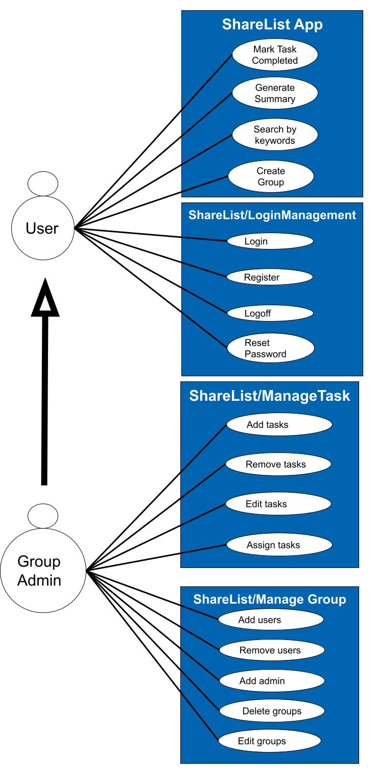
Use Case Diagram

Slide 10
RUCTM
Req ID | Priority Weight | UC 1 | UC 1.1 | UC 1.2 | UC 1.3 | UC 1.4 | UC 2 | UC 2.1 | UC 2.2 | UC 2.3 | UC 2.4 | UC 3 | UC 3.1 | UC 3.2 | UC 3.3 | UC 3.4 | UC 3.5 | UC 4 | UC 5 | UC 6 | UC 7
R1 | 3 | X
R1.1 |  |  | X
R1.2 |  |  |  | X
R1.3 |  |  |  |  | X
R1.4 |  |  |  |  |  | X
R2 | 1 |  |  |  |  |  | X
R2.1 |  |  |  |  |  |  |  | X
R2.2 |  |  |  |  |  |  |  |  | X
R2.3 |  |  |  |  |  |  |  |  |  | X
R2.4 |  |  |  |  |  |  |  |  |  |  | X
R2.5 |  |  |  |  |  |  |  |  |  |  |  |  | X
R2.6 |  |  |  |  |  |  |  |  |  |  |  |  |  | X
R2.7 |  |  |  |  |  |  |  |  |  |  |  |  |  |  | X
R2.8 |  |  |  |  |  |  |  |  |  |  |  |  |  |  |  | X
R2.9 |  |  |  |  |  |  |  |  |  |  |  |  |  |  |  |  | X
R3
R3.1 |  |  |  |  |  |  |  |  |  |  |  |  |  |  |  |  |  | X
R3.2 |  |  |  |  |  |  |  |  |  |  |  |  |  |  |  |  |  |  | X
R4 | 7 |  |  |  |  |  |  |  |  |  |  |  |  |  |  |  |  |  |  | X

Slide 11
RUCTM
Req ID | Priority Weight | UC 1 | UC 1.1 | UC 1.2 | UC 1.3 | UC 1.4 | UC 2 | UC 2.1 | UC 2.2 | UC 2.3 | UC 2.4 | UC 3 | UC 3.1 | UC 3.2 | UC 3.3 | UC 3.4 | UC 3.5 | UC 4 | UC 5 | UC 6 | UC 7
R5 | 1 |  |  |  |  |  | X
R5.1 |  |  |  |  |  |  |  | X
R5.2 |  |  |  |  |  |  |  |  | X
R5.3 |  |  |  |  |  |  |  |  |  | X
R6
R7 | 1 |  |  |  |  |  |  |  |  |  |  | X
R8 | 2
R9 | 4
R10 | 6 |  |  |  |  |  |  |  |  |  |  |  |  |  |  |  |  |  |  |  | X
R10.1 |  |  |  |  |  |  |  |  |  |  |  |  |  |  |  |  |  |  |  |  | X
R10.2 |  |  |  |  |  |  |  |  |  |  |  |  |  |  |  |  |  |  |  |  | X
R10.3 |  |  |  |  |  |  |  |  |  |  |  |  |  |  |  |  |  |  |  |  | X
R11 | 5
Score |  | 3 | 3 | 3 | 3 | 3 | 2 | 2 | 2 | 2 | 1 | 1 | 1 | 1 | 1 | 1 | 1 | 1 | 1 | 7 | 24
Legend | 1 is highest priority. | Work 1 first.

Slide 12
Increment Matrix
Use Case # | Priority | Effort (Person-weeks) | Depends on | Iteration 1 (03/12) | Iteration 2 (04/09) | Iteration 3 (05/03)
UC1 | 3 |  | None
UC1.1 |  | 6 |  |  | 6
UC1.2 |  | 6 |  |  | 6
UC1.3 |  | 6 |  |  | 6
UC1.4 |  | 6 |  |  | 6
UC2 | 2 |  | None
UC2.1 |  | 2 |  | 2
UC2.2 |  | 2 |  | 2
UC2.3 |  | 2 |  |  | 2
UC2.4 | 1 | 3 |  |  | 3
UC3 |  |  | UC 1
UC3.1 |  | 4 |  |  |  | 4
UC3.2 |  | 4 |  |  |  | 4
UC3.3 |  | 4 |  |  |  | 4
UC3.4 |  | 4 |  |  |  | 4
UC3.5 |  | 4 |  |  |  | 4
UC4 |  | 3 | UC 2 |  |  | 3
UC5 |  | 4 | UC 3 |  |  | 4
UC6 | 7 | 2 | UC 2 |  |  | 2
UC7 | 24 | 1 |  |  |  | 1
Total Effort |  | 63 |  | 4 | 29 | 30
1 PW = 5 hrs |  |  |  | 20 | 145 | 150

Slide 13
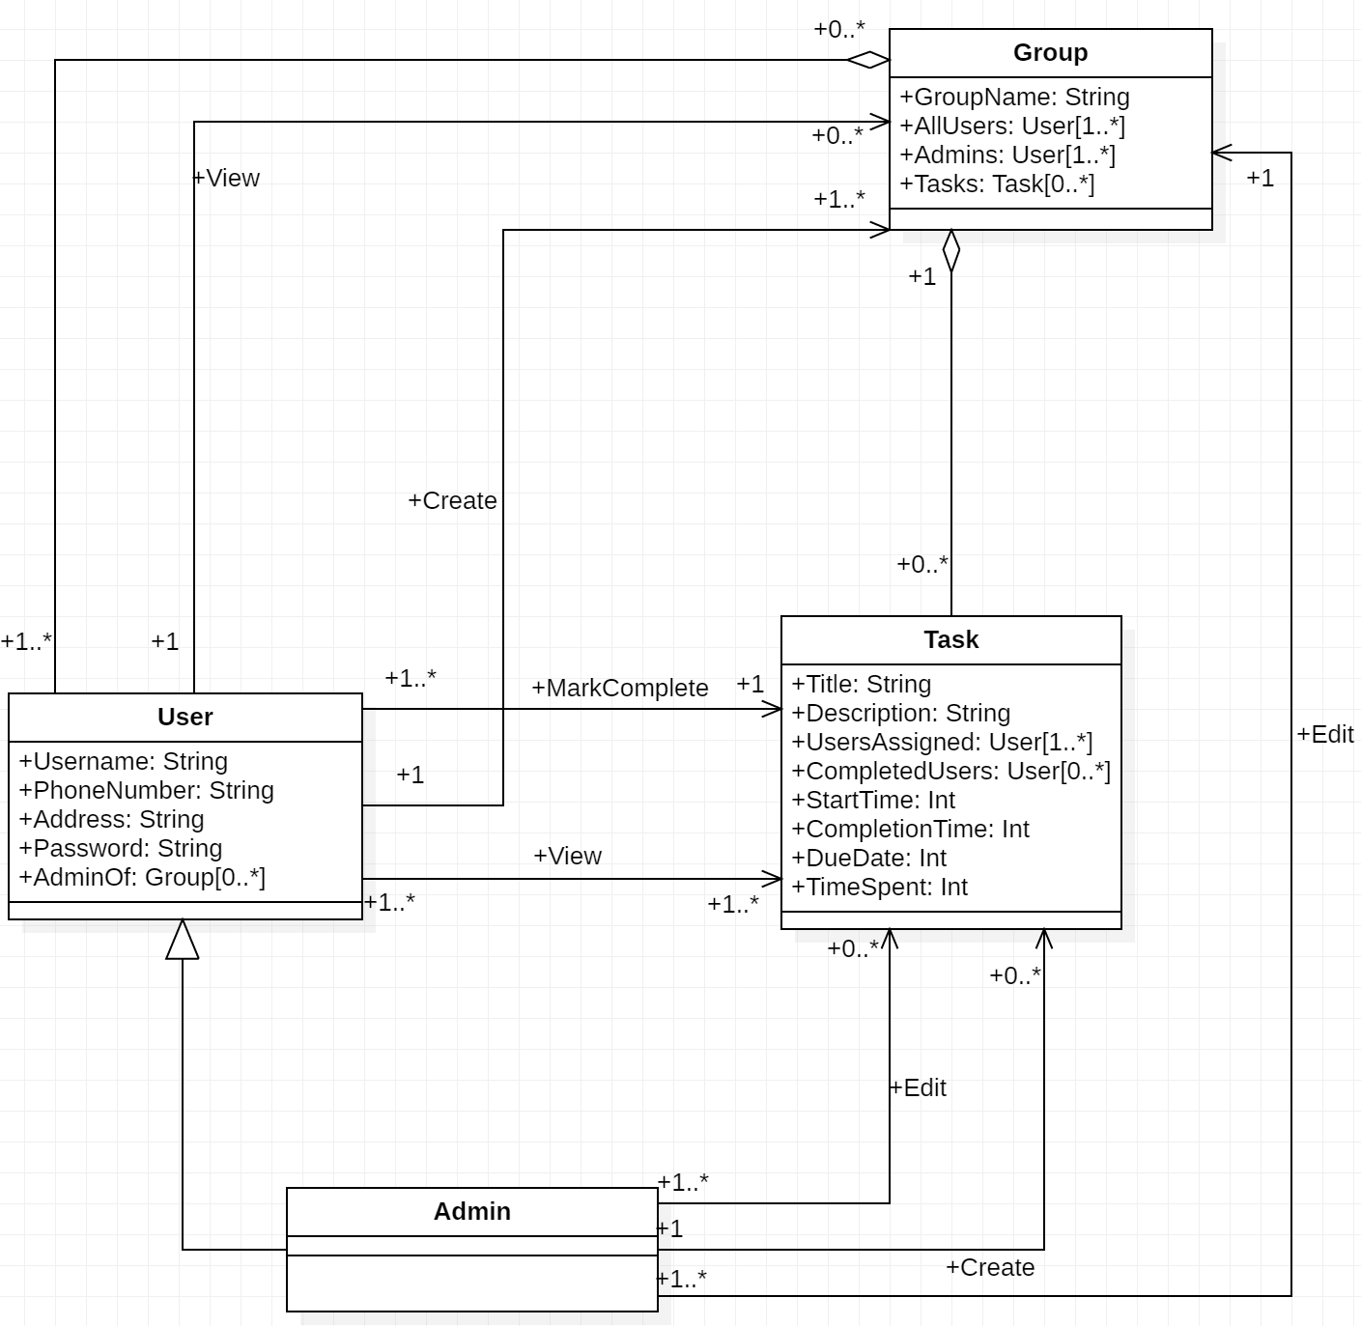
Domain Diagram

Slide 14
Task List
Increment | Task | Assigned to...
1 | Add tasks. | Mohammed & Anum
 | Remove tasks.
2 | Register. | Yanzhi & Yu
 | Login.
 | Manage task. | Mohammed & Anum
 | Edit tasks.
 | Mark task as completed. | Hannan
 | Create groups.
 | Search by keywords.
 | Generate summary.
3 | Log Off. | Yanzhi & Yu
 | Reset password.
 | Assign tasks. | Mohammed & Anum
 | Manage group.
 | Add users.
 | Remove users.
 | Add admins.
 | Delete groups.
 | Edit groups.

Slide 15
Summary
Today we talked about …
ShareList is a task managing app that allows for better collaboration in a virtual environment.
Our overall design approach.
Requirements, Use Cases, RUCTM, Increment Matrix, Domain Diagram.
Our goal is to create this app in 3 iterations.
The first iteration is planning/setup, and the last two iterations are code-heavy.

Slide 16
Thank You

